Slide 1

“Protect Me When I’m Vulnerable”
User study design
Debasis Kar, Deepak Kumar, Abhilash Mishra

Slide 2
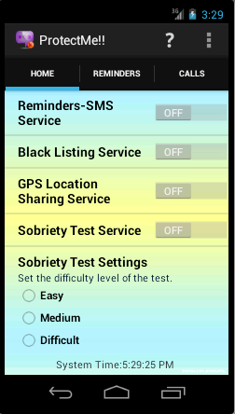
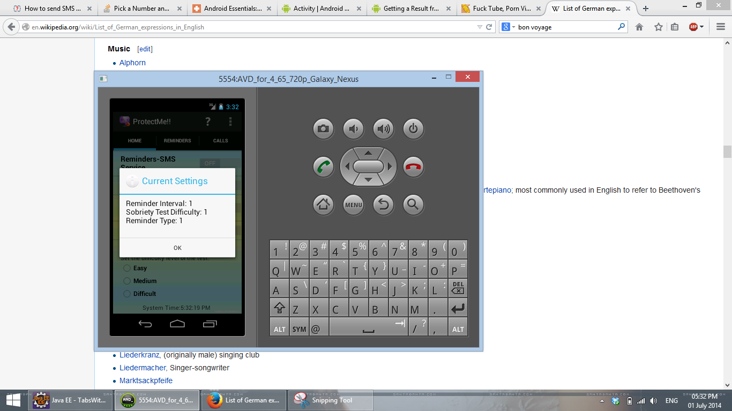
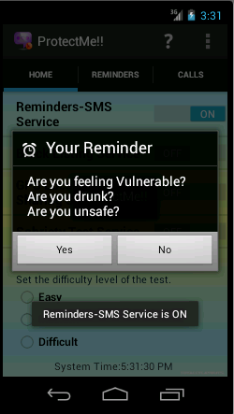
Initial Version of Application

Slide 3
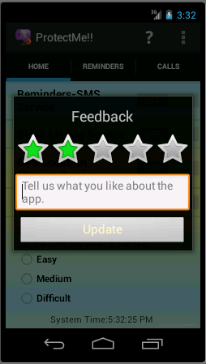
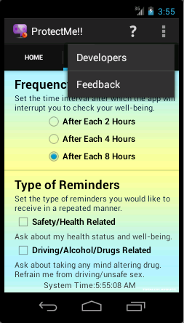
User Feedback Study

Slide 4
User Study
Hypothesis (Statement that we want to evaluate):
Regular notifications are irritating.
Sobriety test is indeed needed.
GUI is the core of the application.
Application is of intended quality.
GUI workflow is moderately easy than other apps.
Population (Intended Users):
Medically Challenged
Susceptible to Mind-altering Substances
Emotionally Weak
Others who may think they are at times vulnerable (General Public)
Method:
Email Based Application Feedback
One-to-One Meeting

Slide 5

THANK YOU!!!

